Slide 1
Human Centred Design 101 Interview testing
This training material was developed by BizLab Academy at DISER and is licensed under a Creative Commons Attribution-NonCommercial-ShareAlike 4.0 International License.

Slide 2
While we wait for people to join
Take 3 minutes to try out the online consent form
Notes:
Normally research participants would receive a consent form a few days before a research session, to give them time to review it and understand it ☺

Slide 3
We'll record this session in the main room but not the breakouts ☺

Slide 4
Who is in the virtual room today?
“Researchers” from course
Our kind volunteer interview participants!

Slide 5
Show of hands
Who has taken part in user research before?

Slide 6
Interviewing
DISCOVER
Learning outcomes
For researchers:
Experience how you might conduct an interview
Reflect on how you might make changes
For volunteer interviewees:
Experience what user research feels like from a participant's perspective
Get a taste test of the course

Slide 7
You’ll get to know someone new today
Hopefully you won’t feel like this…

Slide 8
Groups of 3 – for 12 minutes
Volunteer interviewee
Share’s their experiences in relation to questions they’re asked.
Facilitator
Guides the session, asking the key questions and prompting for further information
Observer
Take notes as the participant is speaking, recording their responses as verbatim as possible and observing and recording their responses.
Notes:
Roles in prototype testing
There are three roles in an interview
The participant: the person who's being interviewed.
The interviewer, or the lead researcher: the person who is asking the questions, prompting the interview, guiding the interview.
The observer: takes notes while the participant is speaking, records their responses as much in their words as possible.
When working as a pair you can have primary and secondary researcher roles, where one person leads and the second person supports and documents.
This doesn’t just benefit the research team, but helps in the interview itself to provide the interviewee with a single focal point for the conversation, and for the primary researcher and interviewee to build rapport and understanding.
If you work in a pair, don’t let one person do all the talking. The secondary researcher has a critical role in supporting the primary researcher, able to follow up on areas of interest, spotting gaps, helping keep the interview on track. Rotating the roles between interviews can be a great way of keeping fresh and avoiding tiredness, too.
The note taker/observer is very important!! What they're doing is capturing the interview, your notes are what we're going to have to use on day two for synthesis. Try to write as much as possible, even if it doesn't seem like it's important. Whatever the person is saying just write it down. Write everything down. Capture body language too, facial reactions to questions
It can be good to clarify the roles at the beginning of the interview: "Good morning, I'm Amy, I'm here to run an interview. I've got Matthew with me. He's observing today, he's going to be madly taking notes and writing down what we're saying.“
The interviewer might want to check with the observer at the end if they have any questions.
Some inteviewers can take notes themselves at the same time. This can be a good way of capturing things that you want to follow up on or probe later

Slide 9
Facilitators and observers get 3 minutes in breakouts to prepare
Facilitator
Observer
Notes:
Facilitators and observers, decide who will be the facilitator and what you want to most spend the time testing in this session.

Slide 10
Take 3 minutes to get comfortable
Volunteer interviewee
Settle in, minimise any distractions and grab a glass of water if you need
Notes:
Facilitators and observers, decide who will be the facilitator and what you want to most spend the time testing in this session.

Slide 11
Quiet reflection – 6 minutes
Lets reflect
Researchers
Volunteers
Using pen and paper, reflect on how that activity felt
How did that feel? Would you do something differently next time?
How did that feel? What did you learn from that activity?
Notes:
10mins max

Slide 12
Time to reflect and discuss in teams
Facilitator
Observer
In your topic teams, you’ll have 10 minutes to discuss if you need to make any changes to your discussion guides before you do more research interview outside of class. If you get stuck, post in your breakout chat and we’ll send help!
Notes:
Roles in prototype testing
There are three roles in an interview
The participant: the person who's being interviewed.
The interviewer, or the lead researcher: the person who is asking the questions, prompting the interview, guiding the interview.
The observer: takes notes while the participant is speaking, records their responses as much in their words as possible.
When working as a pair you can have primary and secondary researcher roles, where one person leads and the second person supports and documents.
This doesn’t just benefit the research team, but helps in the interview itself to provide the interviewee with a single focal point for the conversation, and for the primary researcher and interviewee to build rapport and understanding.
If you work in a pair, don’t let one person do all the talking. The secondary researcher has a critical role in supporting the primary researcher, able to follow up on areas of interest, spotting gaps, helping keep the interview on track. Rotating the roles between interviews can be a great way of keeping fresh and avoiding tiredness, too.
The note taker/observer is very important!! What they're doing is capturing the interview, your notes are what we're going to have to use on day two for synthesis. Try to write as much as possible, even if it doesn't seem like it's important. Whatever the person is saying just write it down. Write everything down. Capture body language too, facial reactions to questions
It can be good to clarify the roles at the beginning of the interview: "Good morning, I'm Amy, I'm here to run an interview. I've got Matthew with me. He's observing today, he's going to be madly taking notes and writing down what we're saying.“
The interviewer might want to check with the observer at the end if they have any questions.
Some inteviewers can take notes themselves at the same time. This can be a good way of capturing things that you want to follow up on or probe later

Slide 13
How did that feel?
Volunteer interviewee
Notes:
Was there any questions that went well – pass back to the teams interviewing.

Slide 14
Thank you to our volunteers!
Thanks for taking part
Notes:
10mins max

Slide 15
Conduct your interviews
Recruit 2 people for 20 minute interviews
Your 2 interviews should take place before the next class
Organise your interviews with your buddy so one of you can lead the interview and the other takes notes. You can then switch roles for your second interview together
Record it if your buddy isn’t there and take notes from recording
Complete the capture sheet
Write your notes into Miro

Slide 16
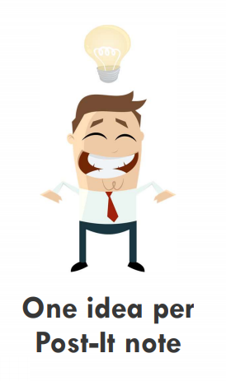
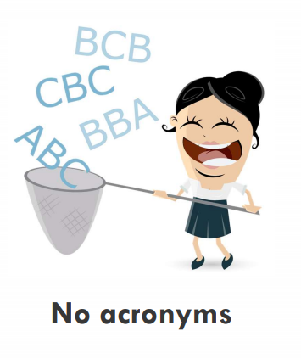
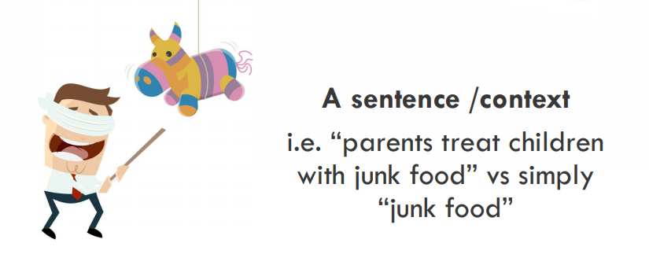
Creating data points
Review your notes and capture sheets from your interviews. Jump into Miro and create notes that include key:
“Quotes”, or
Observations
Code each post-it note according to the interviewer
Researcher initials
Number for interviewee (e.g. P1)
Notes:
A key quote / observation is something that stood out for you (it revealed something new about your user / challenged or confirmed an assumption / changed how you think about your problem)
NOT everything you heard
Watch for personal bias – focus on what was important for the user in the context of your problem. Bias can come if you start writing he said/she said. Only note down observations e.g. seems frustrated at not being able to access learning opportunities or quotes. The easy was to differentiate is put your quotes in “”.
Activity
So you've just done a review of your notes and looked at what key quotes and observations came out. Write these onto Post-It notes.
A note on notes:
Only capture the KEY quotes and observations.
We’re not looking to have everything up on our wall when we’re doing synthesis – we’re looking for the things that seemed significant or surprising, insightful, or something you heard over and over again.
It helps to ask yourself: What stood out from this interview?

Slide 17
Thank you for your time and energy today
Notes:
What’s next…

